Slide 1
Lecture 6: JavaScript, Git/GitHub, Deploying code

Slide 2
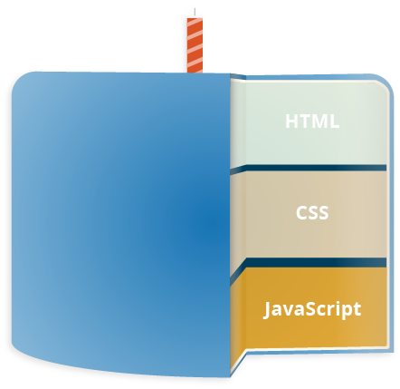
What is JavaScript
“JavaScript is a scripting or programming language that allows you to implement complex things on web pages” - MDN web docs
JavaScript is what makes your website functional and no longer static

Slide 3

JavaScript: A Brief History
In 1995 Netscape Communications recruited Brendan Eich “The Father of JavaScript”
Netscape Communications was about to partner with Sun Microsystems to include Java into Netscape Navigator to compete with Microsoft
Java was not the language Netscape envisioned for its developers
Netscape wanted a faster, easier language for scripters, amateurs, and designers to pick up
Java for big enterprise applications
JavaScript for small scripting tasks

Slide 4
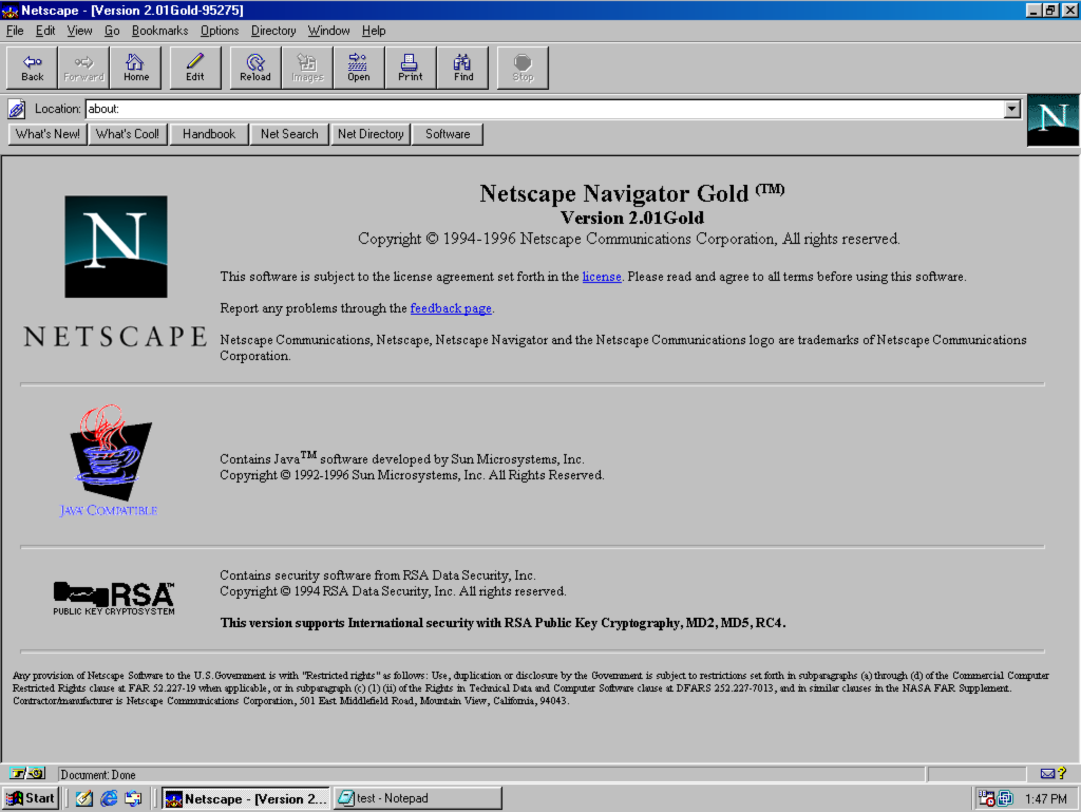
JavaScript: A Brief History contd.
Brendan was able to choose the tools and knew the individuals calling the shots at Netscape to choose what this companion language would be
The only thing he didn’t have was time
In May of 1995 with only 10 days Eich wrote the first JavaScript prototype JavaScript
JavaScript was integrated into Netscape Navigator 2.0 in 1995

Slide 5


Slide 6
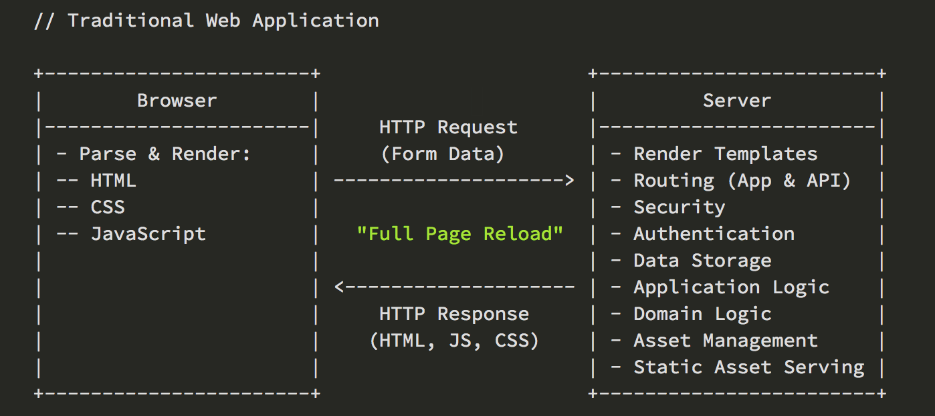
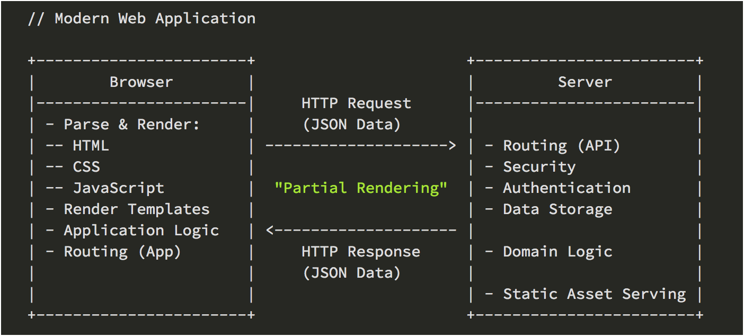
Why is JavaScript important?
JavaScript helps us rewrite Web Applications

Slide 7
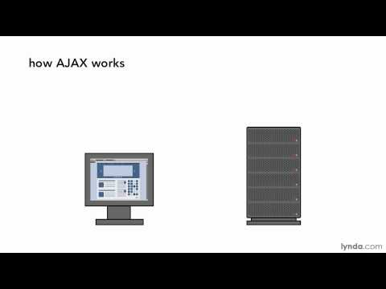
AJAX

Slide 8
Why is JavaScript Important?
Do things HTML & CSS are unable to provide
Write Full stack applications
Client-Side Scripts
Server-Side Code
Enhances the user experience
Create interactivity
Comes in all shapes and sizes
Frameworks
Libraries
Transpilers
JavaScript is:
Analytics
Education
Games
Creativity
Flexibility

Slide 9

Git & GitHub
Git & GitHub have been brought up on multiple occasions and it may not have sunk in yet what is being talked about
Git = Version Control
GitHub = Platform that uses Git

Slide 10

What is Git?
“Git is a free and open source distributed version control system designed to handle everything from small to very large projects with speed and efficiency” - git
Git is a Version Control System
Version control is a system that records changes to a file or set of files over time so you can recall specific version later

Slide 11
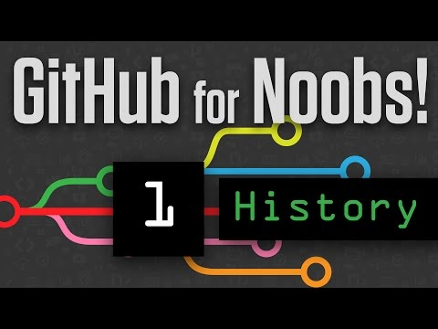

Slide 12
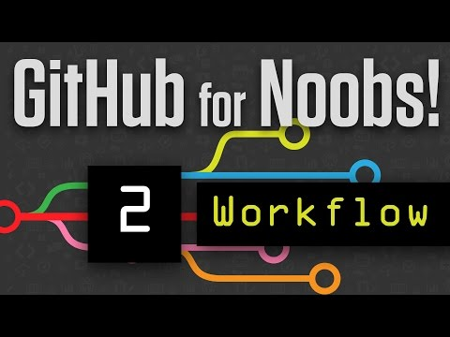

Slide 13
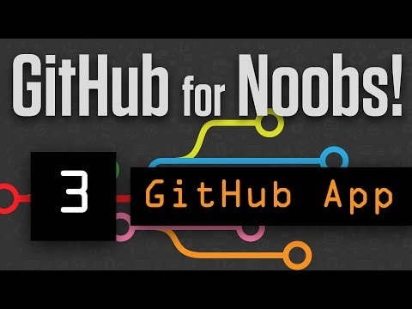
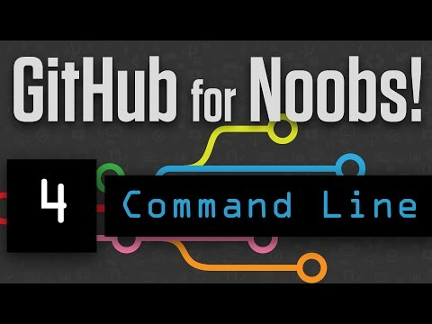
Furthering Git and GitHub knowledge

Slide 14
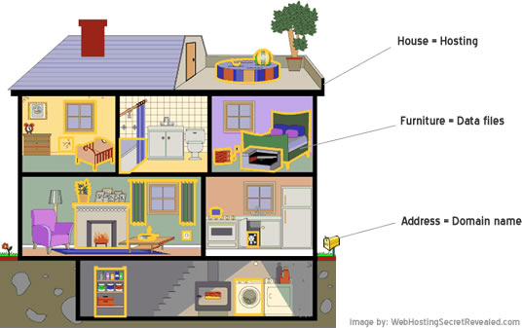
Deploying code to the web
Deploying code on to a web hosting service is no different than working with your local files
Deploying code is like a house
Domain = your address
Hosting = what contains your belongings
Data files = all your belongings

Slide 15

Getting a Domain
Getting a domain is easy, the only challenge is who to pick from
Namecheap
Bluehost
HostGator
GoDaddy
Dreamhost
Domain.com
...just to name a few

Slide 16

Picking where to buy a domain/hosting
The cheapest option is typically fine for personal use
Most places you can get a domain are relatively the same
I use
GoDaddy = Domains
HostGator = Hosting
I’ve worked with clients on various platforms and had the same equal experience
Do your research and imho you’ll find good and bad. I’ve experienced both good and bad with a lot of these services

Slide 17

On a tight budget?
If you are concerned about spending $20 - $30 on a domain and hosting I have good news
GoDaddy Domain = $1.17 (1/yr)
HostGator Hosting - $0.01 (1/mo)
HostGator user offer code HOSTGATOR7994

Slide 18

How to purchase hosting...you can stop at 5 minutes you will not be installing Wordpress

Slide 19
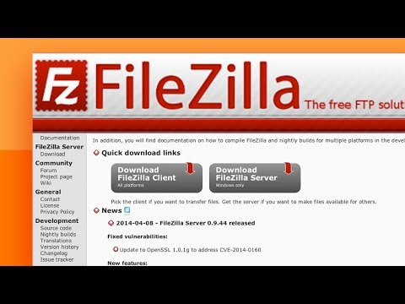
Deploying your code

Slide 20

Homework
For those who will not be here on the 30th you will be expected to have your site online and ready to present
Complete your site and prepare for open lab
Fixing deployment issues
Fixing code issues
Answer questions

